Slide 1



Hadoop Distributed File System (HDFS)
Vidyavardhini’s College of Engineering & Technology
Department of Artificial Intelligence & Data Science
By :
Khushi Upadhyay BE-AI&DS Roll No. 30

Slide 2
Goals of HDFS
Very Large Distributed File System
10K nodes, 100 million files, 10PB
Assumes Commodity Hardware
Files are replicated to handle hardware failure
Detect failures and recover from them
Optimized for Batch Processing
Data locations exposed so that computations can move to where data resides
Provides very high aggregate bandwidth

Slide 3
Distributed File System
Single Namespace for entire cluster
Data Coherency
Write-once-read-many access model
Client can only append to existing files
Files are broken up into blocks
Typically 64MB block size
Each block replicated on multiple DataNodes
Intelligent Client
Client can find location of blocks
Client accesses data directly from DataNode

Slide 4
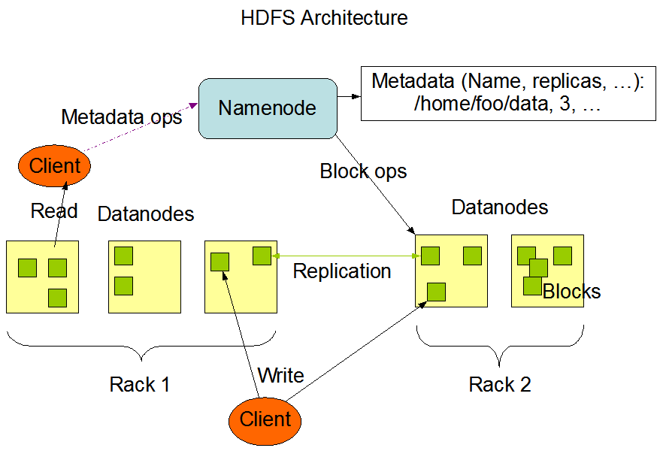
HDFS Architecture

Slide 5
NameNode(MasterNode):
Manages all the slave nodes and assign work to them.
It executes filesystem namespace operations like opening, closing, renaming files and directories.
It should be deployed on reliable hardware which has the high config. not on commodity hardware.

Slide 6
DataNode(SlaveNode)
Actual worker nodes, who do the actual work like reading, writing, processing etc.
They also perform creation, deletion, and replication upon instruction from the master.
They can be deployed on commodity hardware.

Slide 7
Terms related to HDFS:
HeartBeat : It is the signal that datanode continuously sends to namenode. If namenode doesn’t receive heartbeat from a datanode then it will consider it dead.
Balancing : If a datanode is crashed the blocks present on it will be gone too and the blocks will be under-replicated compared to the remaining blocks. Here master node(namenode) will give a signal to datanodes containing replicas of those lost blocks to replicate so that overall distribution of blocks is balanced.
Replication:: It is done by datanode.

Slide 8
Features:
Distributed data storage.
Blocks reduce seek time.
The data is highly available as the same block is present at multiple datanodes.
Even if multiple datanodes are down we can still do our work, thus making it highly reliable.
High fault tolerance.

Slide 9
Limitations :
Low latency data access: Applications that require low-latency access to data i.e in the range of milliseconds will not work well with HDFS, because HDFS is designed keeping in mind that we need high-throughput of data even at the cost of latency.
Small file problem: Having lots of small files will result in lots of seeks and lots of movement from one datanode to another datanode to retrieve each small file, this whole process is a very inefficient data access pattern.

Slide 10
Thank You

